Slide 1
COVID 19
TEAM LINEAR
AND IT’S RELATIONSHIP WITH DISEASE…
ENTITY ACADEMY– POWERED BY WOZU
Notes:
Welcome to Team Linear final Project. Our project will discuss Covid 19 relationship with death and the underlying diseases that affected the vaccinated (MNRA) and unvaccinated in 191 countries around the world.
Sharron

Slide 2


SHARRON DEMBELE
54 YEARS OLD
LIVES IN FLORIDA/CANADA
MASTERS DEGREE - PROCUREMENT AND ACQUISITION MANAGEMENT
DEGREE – POLITICAL SCIENCE and GEOGRAPHY
SHAWN LYNN SKYLES
54 YEARS OLD
LIVES IN IOWA
ASSOCIATES DEGREE - WEB DESIGN
ASSOCIATES DEGREE - NETWORKING
Hobbies: Lampworking, Jewelry making & DIY projects
Notes:
Shawn: I have been working the last 3 years for the local school district as a high school paraprofessional, but have always been intrigued by data and just computer science in general. Looking forward to expanding my reach in the understanding of our world through data. Data is everywhere and the more i learn about it the more answers there are to all of my many questions.
SHARRON: I love to read, no particular genre–just a life-long learner.
Traveling and meeting people of diverse cultures.
federal government retired 2015 private sector in contracting field
government & advocacy fellow for world vision in washington dc.
my future- “i am looking to take my data analyst career back into more meaningful opportunities within the nonprofit sector”

Slide 3
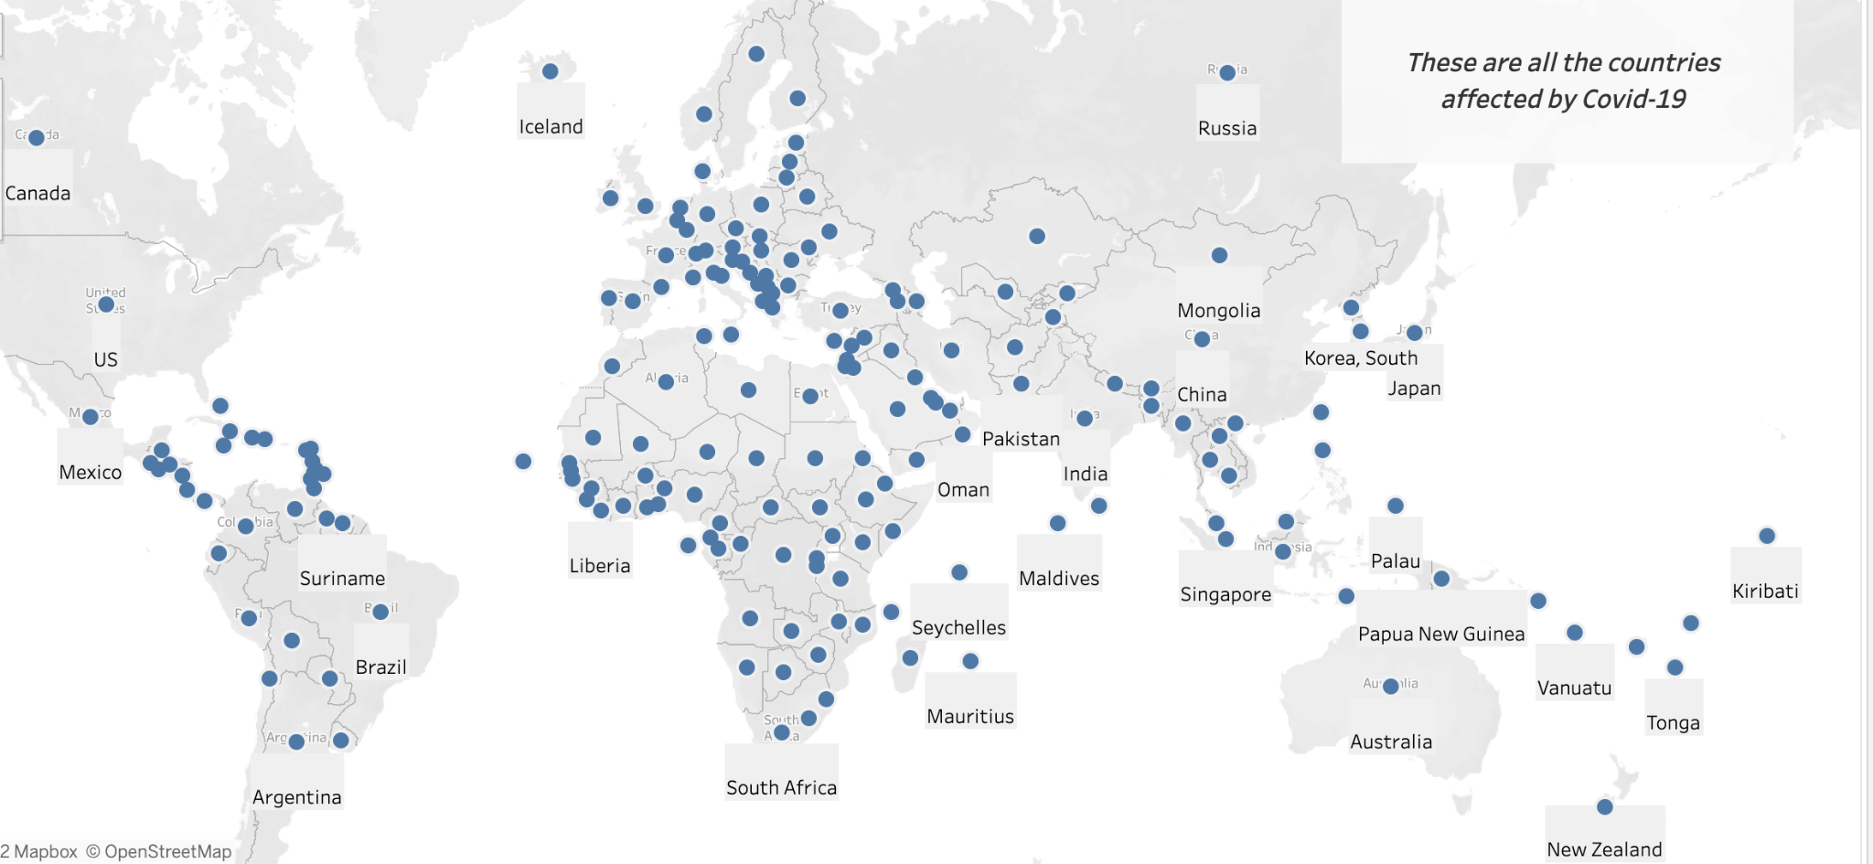
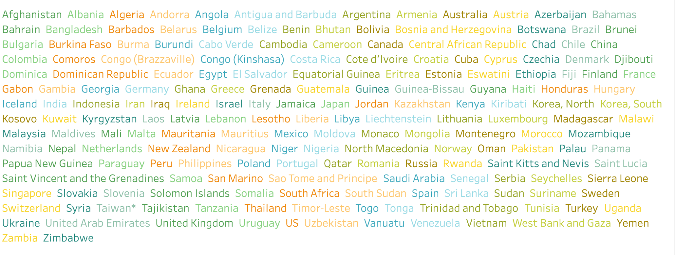
191 COUNTRIES HAVE BEEN AFFECTED BY COVID..
Notes:
every country has been affected by Covid, 191 countries to be exact
This analysis consists of a details concerning which countries were most affected by covid mortality, Which diseases were most associated with covid, and whether or not natural immunity is more effective than full vaccination?
Shawn

Slide 4
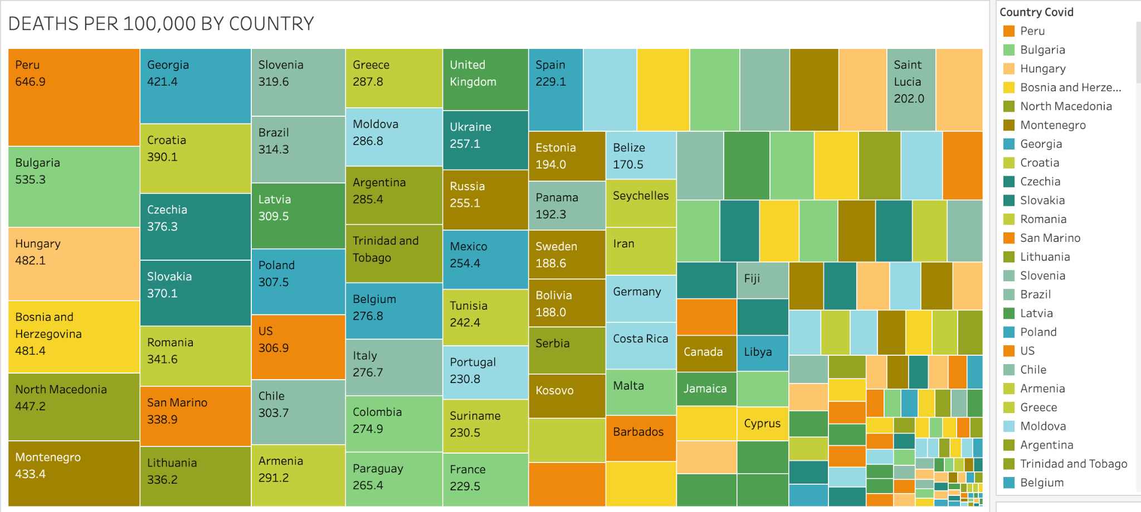
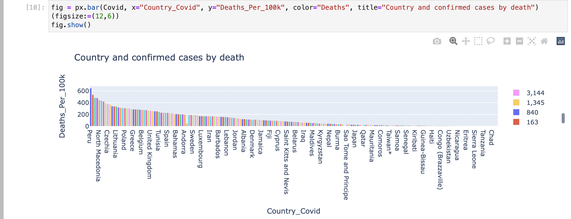
THIS GRAPH SHOWS COVID-19 COUNTRY RELATED DEATHS PER 100K GROUPED BY CONFIRMED CASES (3,588,697).
PERU HAVING A SMALLER POPULATION HOWEVER THEIR CONFIRMED CASES WERE MUCH HIGHER DEATHS PER 100K.
THESE COUNTRIES WERE IMPACTED THE HARDEST PERU, BULGARIA, HUNGARY HAVING THE MOST DEATHS PER 100K
SOME OF THE COUNTRIES DIDN’T HAVE THE INFRASTRUCTURE TO RECORD COVID 19 RELATED DEATHS
Notes:
Overall confirmed Cases and death by disease types are shown
Peru having a smaller population however their Confirmed Cases were much higher Deaths per 100K.
The countries were impact the hardest Peru, Bulgari, Hungary having the most deaths per 100K
Some of the countries didn’t have the infrastructure to record Covid 19 related deaths
Sharron

Slide 5
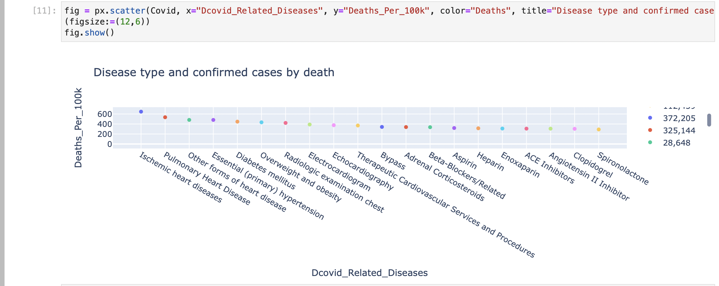
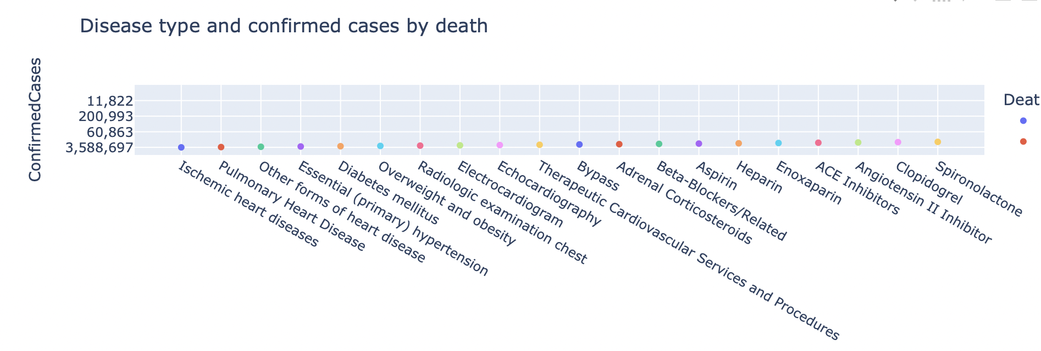
Confirmed Cases/Deaths Per100K
Notes:
The data in above graph is showing the relationship of Covid-19 related disease with the total Confirmed Cases by death.
Covid 19 impact was highest in Ischemic (ISS KEEMIC) heart disease with Confirmed Cases @ 3,588,697 (overall deaths at 213,308)
Falling in close 2nd is Pulmonary Heart disease with Confirmed Cases @ 1,166,777 (overall deaths at 37,196)
Falling in close 3rd is Other forms of heart disease Confirmed Cases @ 1,921,486 (overall deaths at 46,571)
Sharron

Slide 6
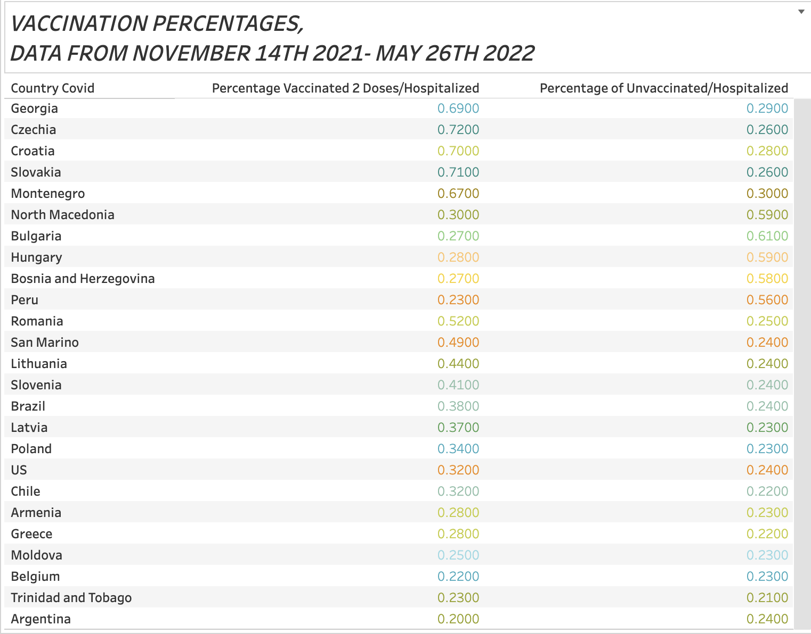
DURING THIS TIME FRAME OMICRON WAS ENTERING INTO PLAY AND WE WERE NOT IMMUNE TO THE NEW VARIANT. SO IT MAKES SENSES THAT THE NUMBERS WERE RISING.
Notes:
here we have a chart with the countries that were reporting, dated during the timeframe of november 14th through may 26th, these percentages show the percentage of vaccinated with two doses being hospitalized, also unvaccinated and hospitalized, as you can see covid was on the rise even for those who are vaccinated, why? during this time frame was when omicron was entering into play and we were not immune to the new variant. so it makes senses that the numbers were rising.
Sharron

Slide 7
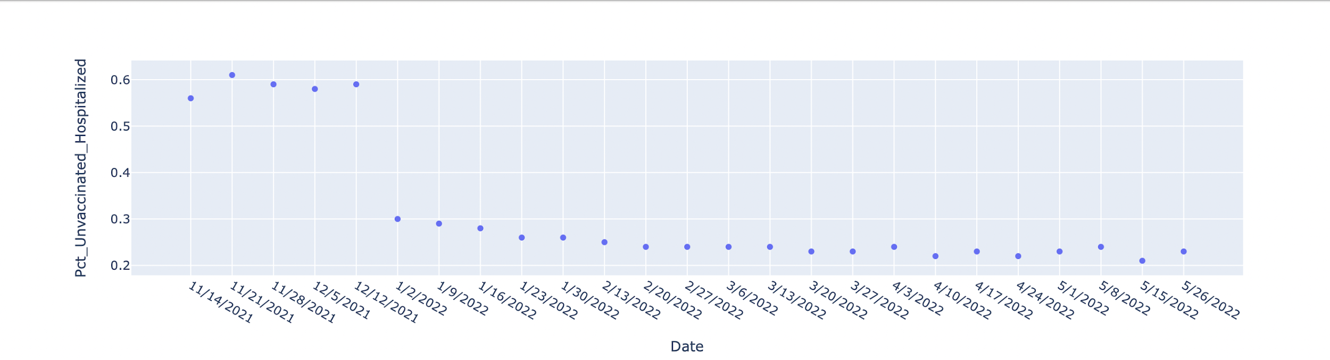
Patients Unvaccinated Hospitalized
Notes:
The above graphs are showing the hospitalization of unvaccinated individuals from mid Nov 2021 to end of May 2022.
Omicron variant overtook the Delta Variant and was present in 179 countries in Nov 2021
This is the dominate strain up to now
Also the unvaccinated had high hospitalizations from Nov 14, 21- January 2nd 2022 due to having no protection against Covid 19 or the Delta Variant
Starting Jan 2nd 2022 hospitalization decreased by half and in May there was hardly any unvaccinated hospitalized
Sharron

Slide 8
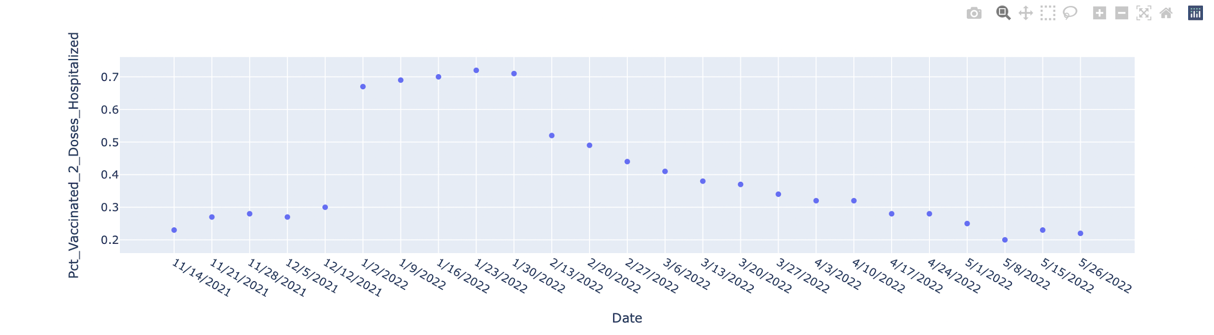
Patients Vaccinated 2 Doses Hospitalized
Notes:
This graph gives info on patients vaccinated with 2 doses that were in the hospital. You can see in the beginning of Nov and the 1st part of January that Omicron was on the rise and those that were vaccinated with 2 doses and still in the hospital at a rate at twice many, the vaccine still not protect them from the strain of Omicron, it is just like being unvaccinated,
Sharron

Slide 9
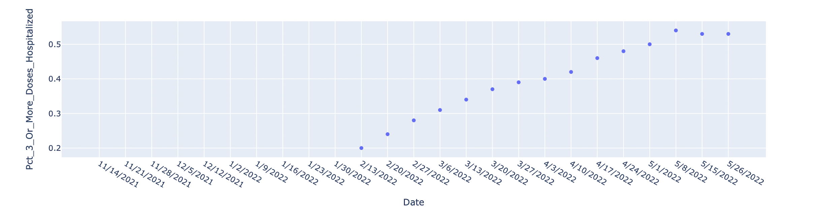
Patients Vaccinated 3 or more Doses Hospitalized
Notes:
October 2021 they were administering the 3rd dose of the vaccine for the delta variant for the high risk population, to boost their immunity. as you can see on this graph, the hospitalized drastically increased due to Omicron and no one had immunity to that strain. the data shows that you had a higher chance of getting hospitalized with 3 0r more doses than an unvaccinated individual
Sharron

Slide 10
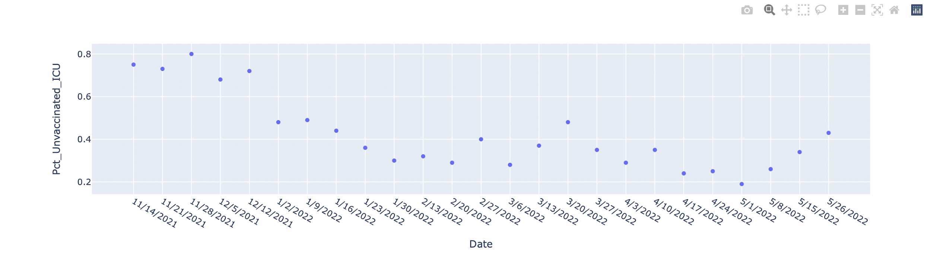
Unvaccinated ICU
Notes:
Unvaccinated ICU were very high, the unvaccinated were filling the ICUs as you can see by the numbers, In january 2022 it decreased due to people having natural immunity
Sharron

Slide 11
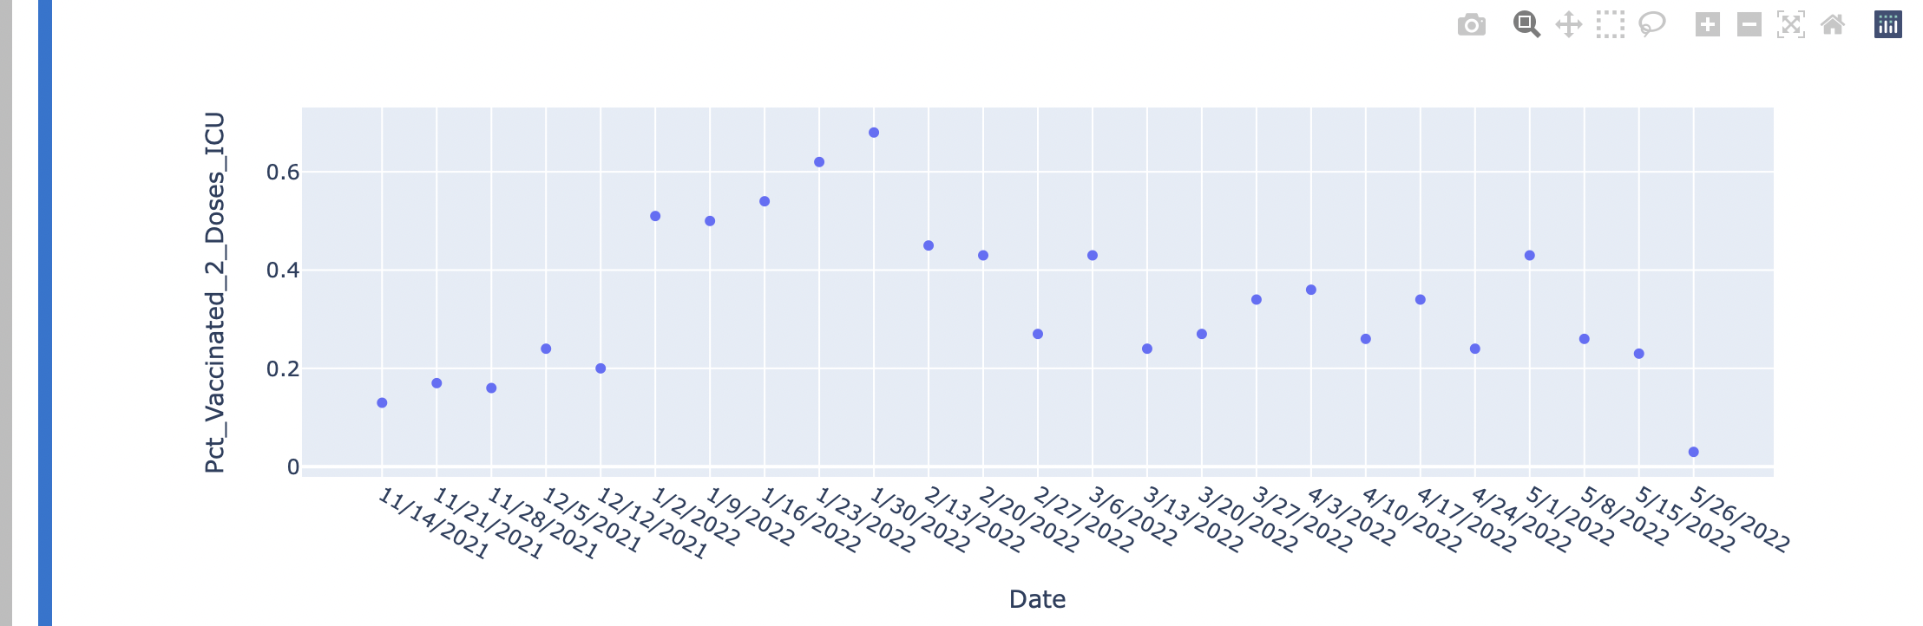
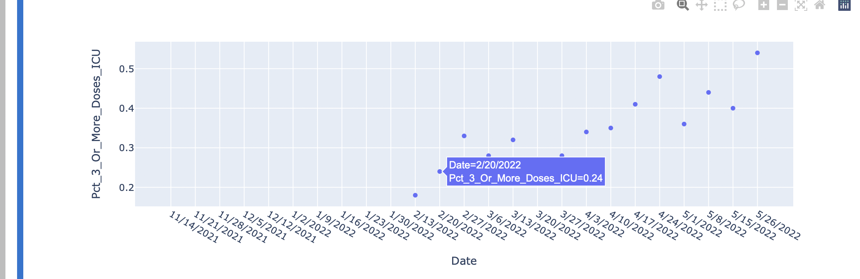
Vaccinated 2 doses ICU/Vaccinated 3 or more doses ICU
Notes:
This data is showing people with 2 doses in ICU & 3 in ICU. What we see here is that people who have 2 doses were more protected than those with two or more
Bottom graph shows that onset of Omicron and hospitalization were higher and kept increasing .
shawn

Slide 12
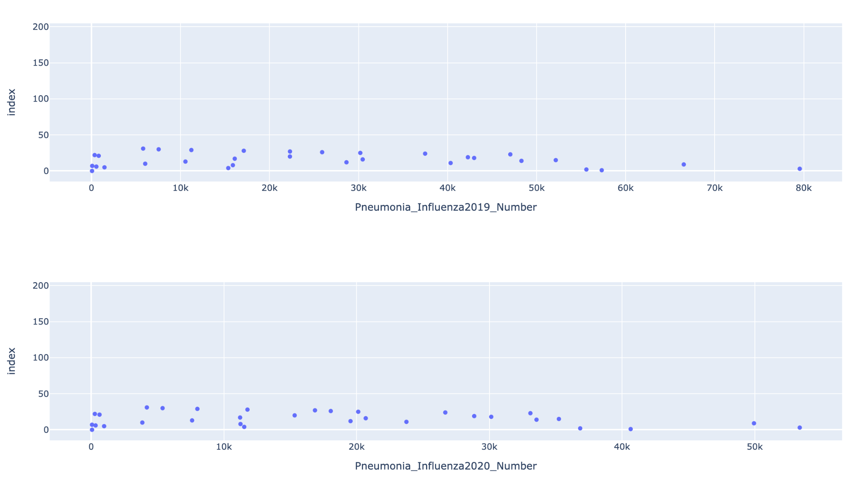
Pneumonia/Influenza 2019-2020
Notes:
let’s talk about Pneumonia and Influenza, in 2019 & 2020 there was no change in numbers and there is normal distribution and numbers during this period. In 2020 less people were getting Pneumonia and Influenza, as Covid was on the rise
Shawn

Slide 13
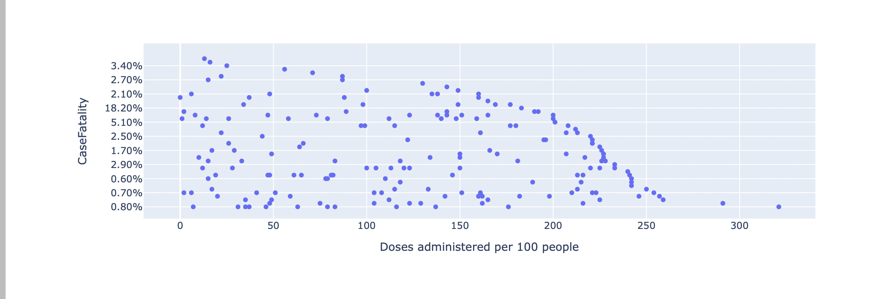
Not a high correlation between the doses and fatality rate per 100 people per Johns Hopkins Data
Notes:
This data was taken from Johns Hopkins website, it shows no high correlation between the doses of administered vaccine and the fatality rate per 100 people, although in the future as more data is taken, I’m sure we will see these numbers change.
shawn

Slide 14
Which Disease is Most Related to COVID?
There were 3 stand-out disease mostly related to Covid
Ischemic heart disease with deaths per 100K @ 646.94(overall deaths at 213,308)
Pulmonary Heart disease deaths per 100K @ 535.31(overall deaths at 37,196)
Other forms of heart disease deaths per 100K @ 482.08(overall deaths at 46,571)
Notes:
we already brought this data up briefly earlier, however this data answers the question and shows you the diseases most related to Covid and the mortality rate, meaning Covid affected those with Ischemic heart disease, Pulmonary Heart and other form of heart disease and these numbers are overall deaths per 100,000..
Shawn

Slide 15
Which is more effective Unvaccinated vs Vaccination?
Both ICU and hospitalization..
Data shows that the unvaccinated hospitalization and ICU stays were the highest in the month of Nov in 2021.
The Unvaccinated and vaccinated have almost the same hospitalization and ICU admissions across the board (worldwide) From Dec 2021 to May 2022.
The vaccine has ZERO immunity towards both Delta and Omicron variant that was detected in Nov 2021 the distribution of the unvaccinated (Natural immunity) and partial vaccination (or 2 doses) are both far more effective than the full vaccinated of 3 or more doses.
Notes:
Which is more effective, the unvaccinated or the vaccinated?? Omicron is no longer the dominant strain, since late June, last month the BA.4 and BA.5, new strains, have accounted for 36.6% of the country’s new reported cases.
Shawn

Slide 16
Which countries were affected the most with COVID?
Countries impacted the most…
Peru, Bulgaria & Hungary having the highest amount of confirmed cases with most deaths per 100K
Data also suggests that some countries neither recorded their confirmed cases nor number of deaths, this can be attributed to poor or no data collect systems in place
(Yemen 18%) hiding the true numbers and metrics (China 0.70%). 2M+ confirmed cases and 14K+ deaths. (North Korea 600%) with it’s 1 covid-19 related death and 6 confirmed cases.
Notes:
Overall the countries affected most Peru, Bulgaria and Hungary having the highest amount, But looking at overall numbers it shows that these countries may not have recorded correctly or maybe not at all as these smaller and underdeveloped countries may not have the ability to record correctly. As time goes by this will show different numbers as these countries will become more developed and able to report the correct numbers.
On behalf of Sharron and myself ….Thanks for listening and being here for this informative presentation..
Shawn

